Slide 1
DIELECTRICS

Slide 2
Characteristics
Electrical Insulation: High electrical resistivity, making them effective insulators that prevent the flow of electric current. This property is crucial in applications where electrical isolation and safety are critical.
Polarization: When exposed to an electric field, dielectrics undergo polarization,. - store electrical energy- utilized in devices like capacitors
Dielectric Strength: Dielectrics possess the ability to endure high electric fields without experiencing breakdown, referred to as dielectric strength. This characteristic is essential in high-voltage applications such as power distribution systems

Slide 3
Applications
Capacitors: One of the primary applications of dielectrics is in capacitors, where they facilitate the storage of electrical charge..
Insulation: Dielectrics act as electrical insulators in cables, transformers, and electrical equipment, preventing current leakage and ensuring safe operation.
Electronics: dielectrics are used in integrated circuits (ICs) to insulate and separate conductive layers, in printed circuit boards (PCBs) as substrate materials, and in semiconductor devices to provide electrical isolation.
Telecommunications: Dielectrics play a critical role in optical fibers and waveguides, guiding and transmitting electromagnetic waves with minimal loss.
Medical Applications: Dielectrics are employed in medical devices and equipment such as MRI machines .

Slide 4
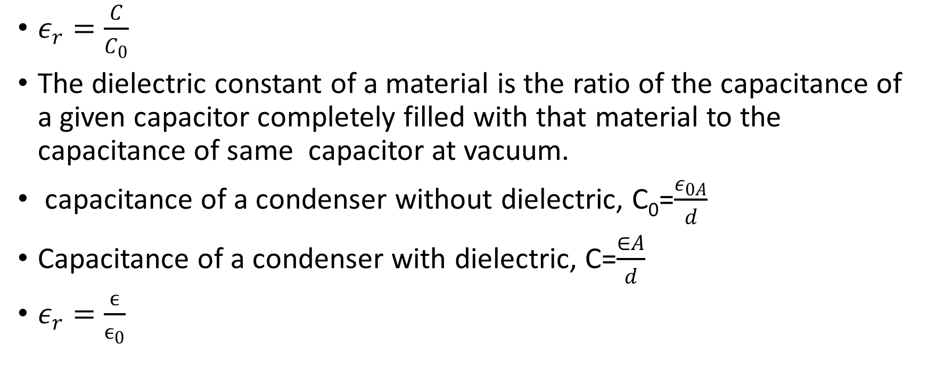
Dielectric constant
$ε_{r}=\frac{C}{C_{0}}$
The dielectric constant of a material is the ratio of the capacitance of a given capacitor completely filled with that material to the capacitance of same capacitor at vacuum.
capacitance of a condenser without dielectric, C₀=$\frac{ε_{0A}}{d}$
Capacitance of a condenser with dielectric, C=$\frac{∈A}{d}$
$ε_{r}=\frac{ϵ}{ϵ_{0}}$

Slide 5
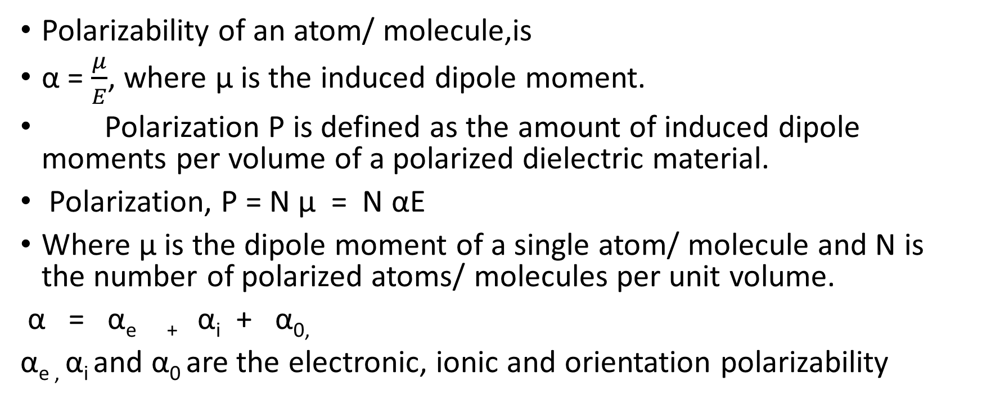
Polarisation
Polarizability of an atom/ molecule,is
α = $\frac{μ}{E}$, where μ is the induced dipole moment.
Polarization P is defined as the amount of induced dipole moments per volume of a polarized dielectric material.
Polarization, P = N μ = N αE
Where μ is the dipole moment of a single atom/ molecule and N is the number of polarized atoms/ molecules per unit volume.
α = α_{e +} α_{i} + α_{0,}
α_{e ,} α_{i} and α₀ are the electronic, ionic and orientation polarizability

Slide 6
Types of polarisation
The application of electric field to a dielectric material forms electric dipole resulting in
polarisation. Here are four different types of polarisation as follows.
Electronic polarisation
Ionic polarisation
Orientation Polarisation
Space charge polarisation

Slide 7
Electronic polarisation
It is the polarisation of a single atom in a dielectric material. An atom is having a positive nucleus at its centre while the electrons are revolving around it. When an electric field is applied to this atom, the electrons are displaced with respect to the heavy fixed nuclei to a distance less than the dimension of the atom. This is called electronic polarisation. This is proportional to the field strength E.
The electronic polarisation, P_{e} = N α_{e} E
where N number of atoms per unit volume and α_{e} the electronic polarizability

Slide 8
When the atom of a dielectric material is placed in an electric field of intensity E , the electron cloud will move in a direction opposite to the field direction. Then the Lorentz force ,
F_{L} = charge X electric field
= ze E, where z is the atomic number.

Slide 9
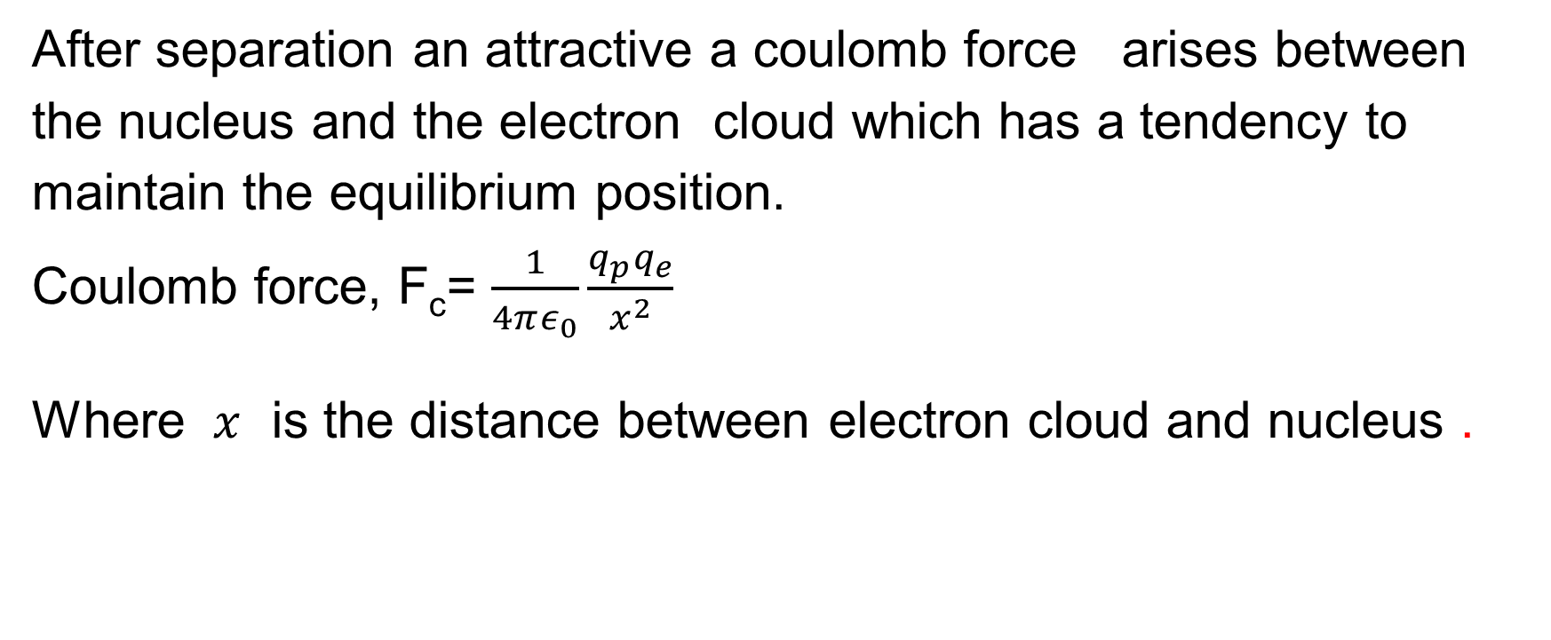
After separation an attractive a coulomb force arises between the nucleus and the electron cloud which has a tendency to maintain the equilibrium position.
Coulomb force, F_{c}= $\frac{1}{4πε_{0}}\frac{q_{p}q_{e}}{x^{2}}$
Where $x$ is the distance between electron cloud and nucleus .

Slide 10
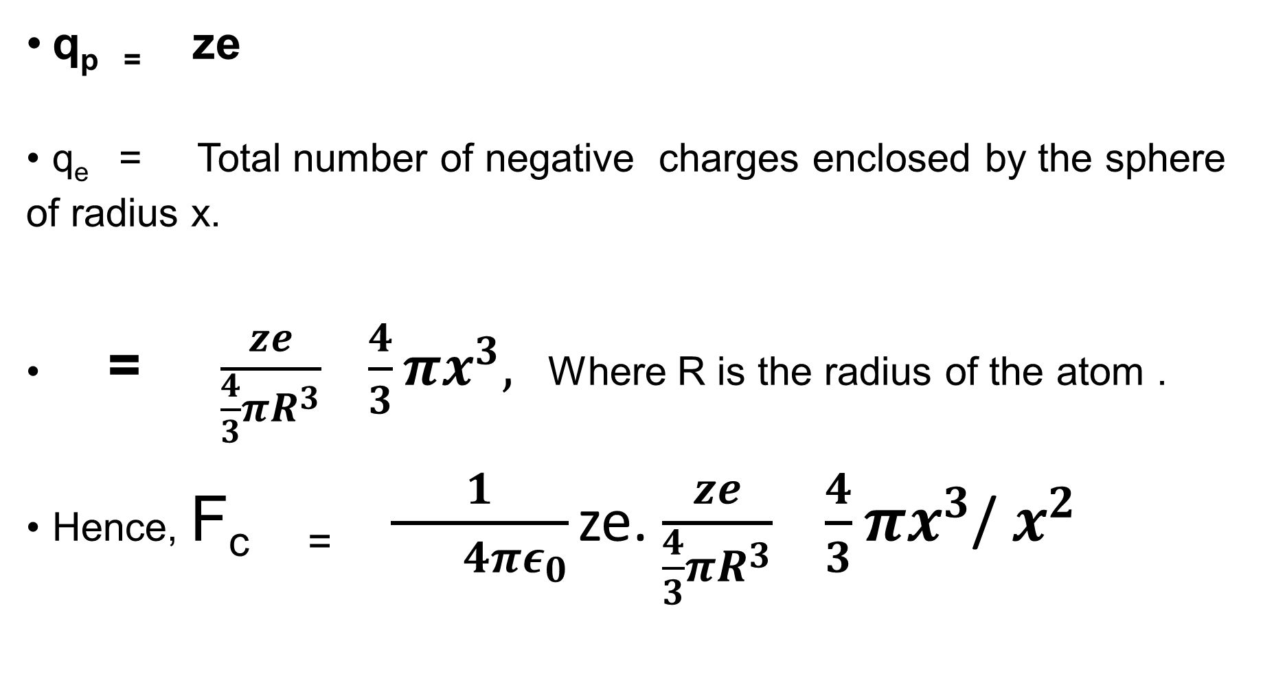
q_{p =} ze
q_{e} = Total number of negative charges enclosed by the sphere of radius x.
= $\frac{ze}{\frac{4}{3}πR^{3}} \frac{4}{3}πx^{3},$ Where R is the radius of the atom .
Hence, F_{c =} $\frac{1}{ 4πε_{0}}$ze. $\frac{ze}{\frac{4}{3}πR^{3}} \frac{4}{3}πx^{3}$/ $x^{2}$

Slide 11

At equilibrium, F_{L}= F_{c}
ze E = $\frac{z^{2}e^{2}x}{4πε_{0}R^{3}}$
Or $x= \frac{4πε_{0}R^{3}E}{ze}$
The induced dipole moment ,$μ_{e}$ = magnitude of charge X displacement
= ze $x$
=$4πε_{0}R^{3}E$

Slide 12
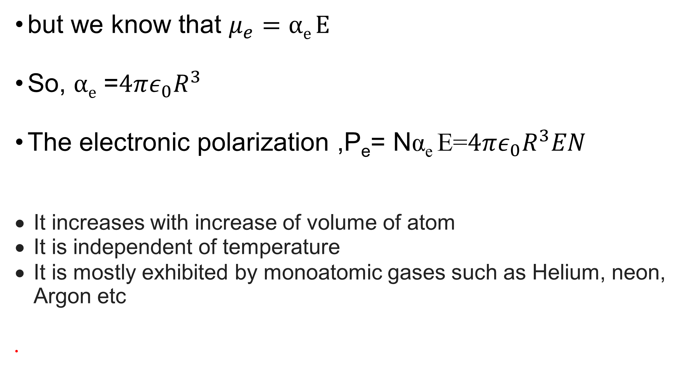
but we know that $μ_{e}=αe E$
So, $αe$ =$4πε_{0}R^{3}$
The electronic polarization ,P_{e}= Nα_{e} E=$4πε_{0}R^{3}EN$
It increases with increase of volume of atom
It is independent of temperature
It is mostly exhibited by monoatomic gases such as Helium, neon, Argon etc

Slide 13
Ionic polarisation
When an electric field is applied to an ionic crystal such as NaCl, KCl, KBr etc. the positive and negative ions are displaced in the opposite directions in the presence of an external electric field. This is known as atomic or ionic polarisation.
The ionic polarisation produced for a crystal have N number of dipoles per unit volume is given by
P_{i} = N α_{i} E, where α_{i} is the ionic polarizability.

Slide 14
When an electric field E is applied to an ionic dielectric , positive ions move in the direction of applied electric field, where as negative ions move in the opposite direction. Let x₁ and x₂ are the distance moved by positive ions and negative ions respectively .

Slide 15
When the ions are displaced from its equilibrium, a restoring force comes into play which bring the ions back to their mean position. The restoring force is proportional to the displacement.
For the positive ion, restoring force, Fp α x₁
= k₁x₁
and for negative ion ,restoring force, Fn α x₂
= k₂x₂
k₁ and k₂ are proportionality constant which is proportional to mass and angular frequency of respective ions.

Slide 16
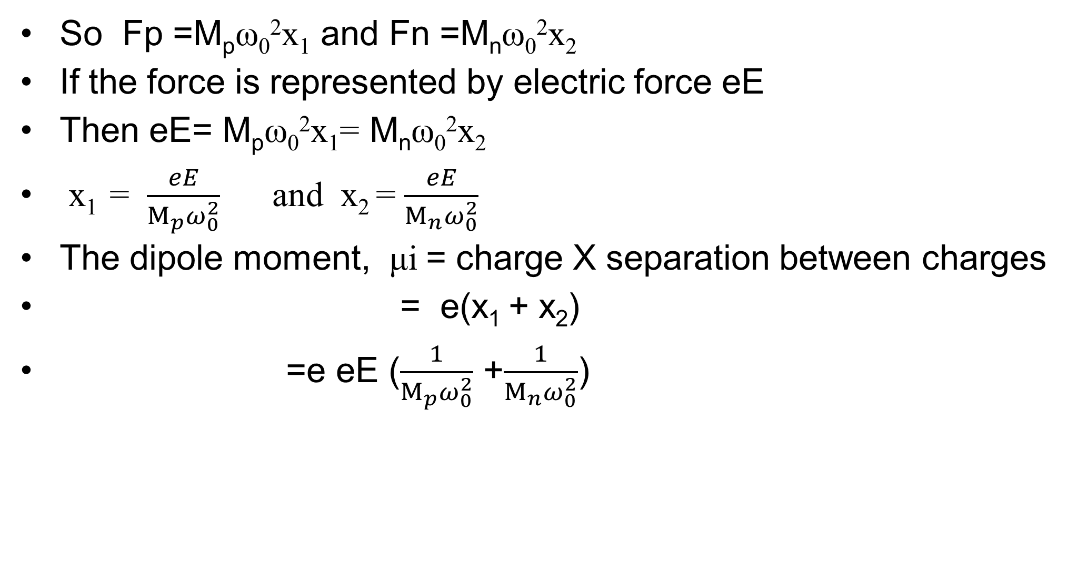
So Fp =M_{p}ω₀²x₁ and Fn =M_{n}ω₀²x₂
If the force is represented by electric force eE
Then eE= M_{p}ω₀²x₁= M_{n}ω₀²x₂
x₁ = $\frac{eE}{M_{p}ω_{0}^{2}}$ and x₂ = $\frac{eE}{M_{n}ω_{0}^{2}}$
The dipole moment, μi = charge X separation between charges
= e(x₁ + x₂)
=e eE ($\frac{1}{M_{p}ω_{0}^{2}}$ +$\frac{1}{M_{n}ω_{0}^{2}}$)

Slide 17

= $\frac{eeE}{ω_{0}^{2}} (\frac{1}{M_{p}}$ +$\frac{1}{M_{n}})$
μ= α_{i}E
so ionic polarizisability, α_{i}= =$\frac{e2}{ω_{0}^{2}} (\frac{1}{M_{p}}$ +$\frac{1}{M_{n}})$
It does not depend on temperature.
In addition to ionic polarisation, the ionic molecule also possess electronic polarisation due to the shifting of electron cloud

Slide 18
Orientation Polarisation
Orientation Polarisation is exhibited by polar molecules such as H₂O, HCl, Phenol etc. In the absence of an electric field, the permanent dipoles are oriented randomly such that it effect are cancelled each other. So the net dipole moment is zero. When an electric field is applied to a polar molecules, the dipole experiences a torque and align parallel to the applied field. This is known as orientation polarisation , which depends on temperature.
Orientation polarisation, P_{o} =Nα_{o} E
where N number of atoms per unit volume and α_{o} the orientation polarizability

Slide 19
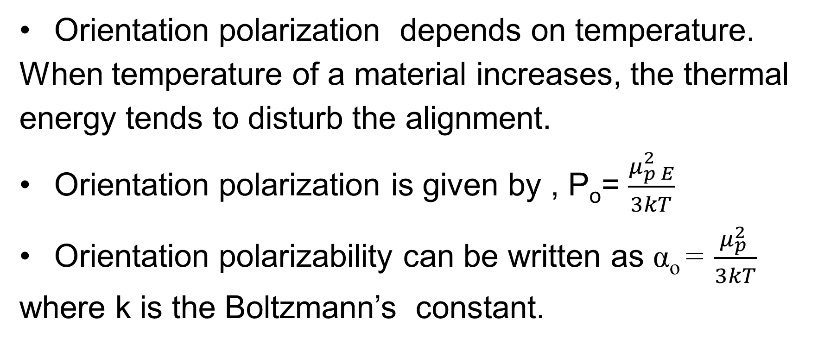
Orientation polarization depends on temperature. When temperature of a material increases, the thermal energy tends to disturb the alignment.
Orientation polarization is given by , P_{o}= $\frac{μ_{p E}^{2}}{3kT}$
Orientation polarizability can be written as α_{o} = $\frac{μ_{p }^{2}}{3kT}$ where k is the Boltzmann’s constant.

Slide 20
Space charge polarisation
Space charge polarisation is due to the presence of a dielectric medium placed in between two electrodes. Here in the absence of electric field positive and negative charges are not separated. When an electric field is applied , the positive charges are accumulated near the negative electrode and negative charges near positive electrode. The space charge polarisation can be defined as the redistribution of charges due to the applied electric field and the charges accumulate on the surface of electrode.

Slide 21
Total polarisation
The total polarisation is the sum of electronic , ionic and orientation polarisation. In the calculation of total polarisation , space charge polarisation is not taken, as it occurs at interfaces and it is very small and hence negligible. Therefore total polarisation,
P = P_{e} + P_{i} + P_{o.}

Slide 22
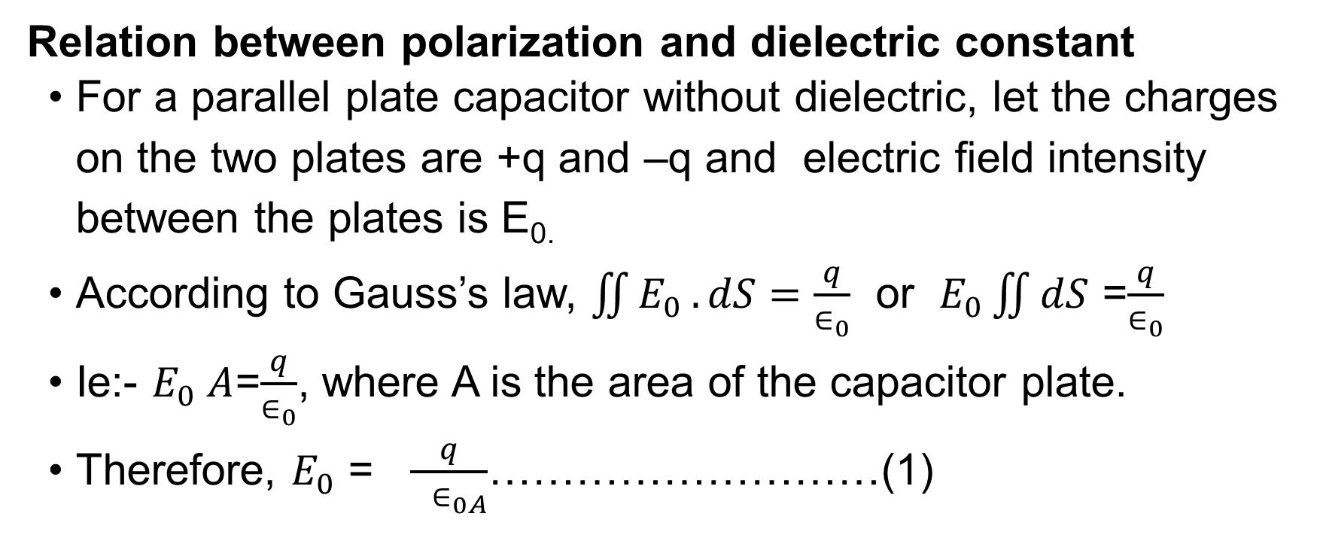
Relation between polarization and dielectric constant
For a parallel plate capacitor without dielectric, let the charges on the two plates are +q and –q and electric field intensity between the plates is E_{0.}
According to Gauss’s law, $\iint{E_{0}}.dS=\frac{q}{∈_{0}}$ or $E_{0}\iint{dS}$ =$\frac{q}{∈_{0}}$
Ie:- $E_{0} A$=$\frac{q}{∈_{0}}$, where A is the area of the capacitor plate.
Therefore, $E_{0}$ = $\frac{q}{{ ∈}_{0A}}$………………………(1)

Slide 23
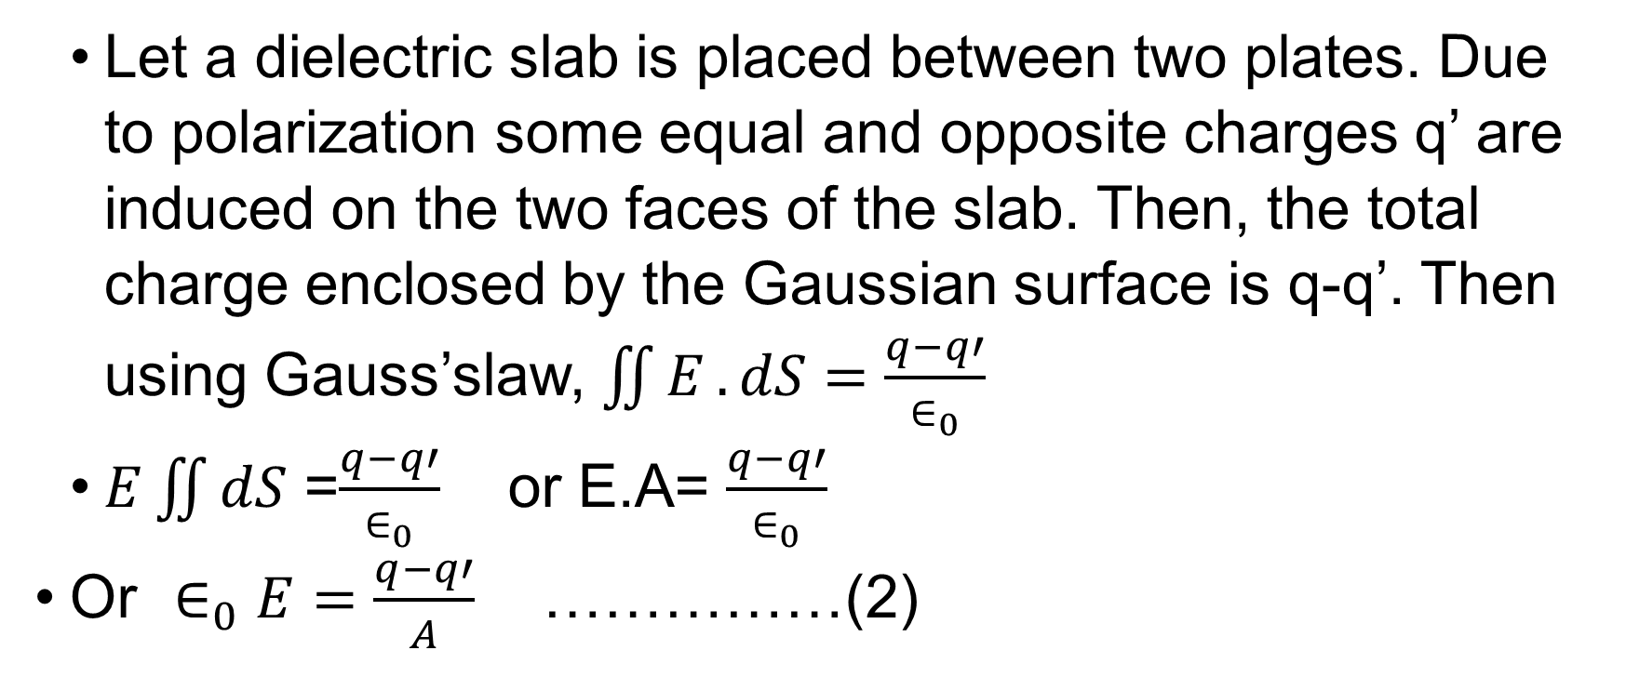
Let a dielectric slab is placed between two plates. Due to polarization some equal and opposite charges q’ are induced on the two faces of the slab. Then, the total charge enclosed by the Gaussian surface is q-q’. Then using Gauss’slaw, $\iint{E}.dS=\frac{q−q′}{∈_{0}}$
$E\iint{dS}$ =$\frac{q−q′}{∈_{0}}$ or E.A= $\frac{q−q′}{∈_{0}}$
Or $∈_{0}E=\frac{q−q′}{A}$ ……………(2)

Slide 24
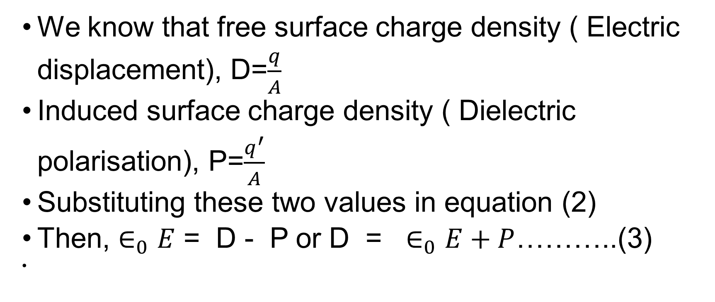
We know that free surface charge density ( Electric displacement), D=$\frac{q}{A}$
Induced surface charge density ( Dielectric polarisation), P=$\frac{q^{′}}{A}$
Substituting these two values in equation (2)
Then, $∈_{0}E$ = D - P or D = $∈_{0}E+P$………..(3)

Slide 25
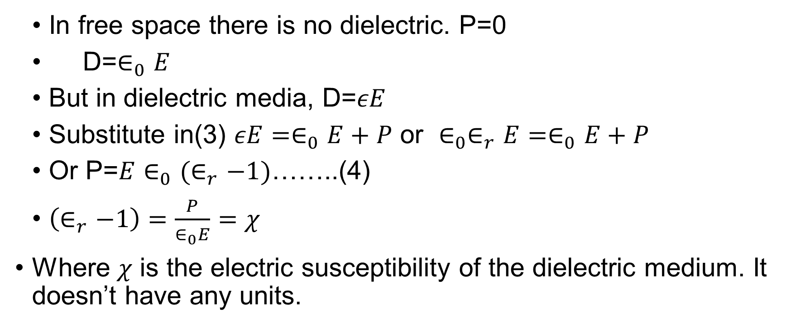
In free space there is no dielectric. P=0
D=$∈_{0}E$
But in dielectric media, D=$εE$
Substitute in(3) $εE=∈_{0}E+P$ or $∈_{0}∈_{r}E=∈_{0}E+P$
Or P=${E∈}_{0}(∈_{r}−1)$……..(4)
$\left(∈_{r}−1\right)=\frac{P}{∈_{0}E}=χ$
Where $χ$ is the electric susceptibility of the dielectric medium. It doesn’t have any units.

Slide 26
Internal fields or local field in liquids and solids
The electric field which is seen by an atom or the total electric field at the atom site is called the internal field or local field. In gases ,the atoms are separated at a large distances and the interaction between the atoms can be neglected.

Slide 27
When an external electric field E is applied , the intensity of electric field experienced by an atom in gaseous state is equal to the applied electric field E. In solids and liquids, atoms are arranged very closely which leads to strong interaction between them. So the internal field Ei of an atom is not equal to externally applied electric field E but equal to the sum of applied field and the field due to other dipoles present in the material.
Internal field Ei= E+ the field due to all other dipoles.

Slide 28
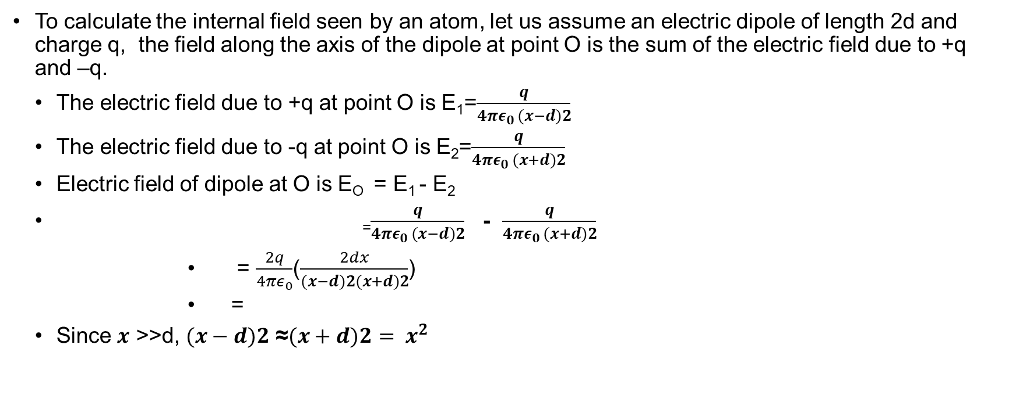
To calculate the internal field seen by an atom, let us assume an electric dipole of length 2d and charge q, the field along the axis of the dipole at point O is the sum of the electric field due to +q and –q.
The electric field due to +q at point O is E₁=$\frac{q}{4πε_{0 }(x−d)2}$
The electric field due to -q at point O is E₂=$\frac{q}{4πε_{0 }(x+d)2}$
Electric field of dipole at O is E_{O} = E₁ - E₂
₌$\frac{q}{4πε_{0 }(x−d)2}$ - $\frac{q}{4πε_{0 }(x+d)2}$
= $\frac{2q}{4πε_{0}}$($\frac{2dx}{(x−d)2(x+d)2}$)
=
Since $x$ >>d, $(x−d)2$ ≈$(x+d)2{= x}^{2}$

Slide 29

E_{O} =$\frac{2q}{4πε_{0}}$($\frac{2dx}{x^{4}}$)
=$\frac{4dqx}{4πε_{0}x^{4}}$
=$\frac{2μ}{4πε_{0}x^{3}}$, since $2dq$ =$μ$

Slide 30
Consider an array of equispaced atomic dipoles separated by a distance ‘a’ as shown in figure 7. The all the atoms are similar, equally spaced and have induced electric dipole moment μi in an applied electric field E. The electric field experienced at the atom X is the sum of electric fields of other dipoles and applied electric field E.

Slide 31
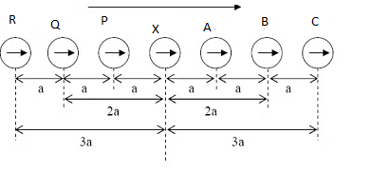
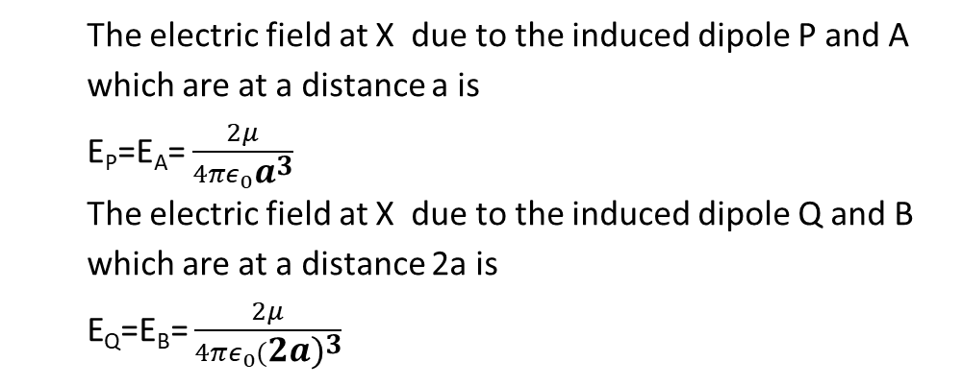
The electric field at X due to the induced dipole P and A which are at a distance a is
E_{P}=E_{A}= $\frac{2μ}{4πε_{0}a^{3}}$
The electric field at X due to the induced dipole Q and B which are at a distance 2a is
E_{Q}=E_{B}= $\frac{2μ}{4πε_{0}({2a)}^{3}}$

Slide 32

Therefore thel field
due to all other dipoles = E_{P}+E_{A} + E_{Q}+E_{B} + E_{R} + E_{C}+………………
=$\frac{2μ}{4πε_{0}a^{3}}$ +$\frac{2μ}{4πε_{0}a^{3}}$ +$\frac{2μ}{4πε_{0}({2a)}^{3}}$ +$\frac{2μ}{4πε_{0}({2a)}^{3}}$ +$\frac{2μ}{4πε_{0}({3a)}^{3}}$ +$\frac{2μ}{4πε_{0}({3a)}^{3}}$ +……….
=$\frac{4μ}{4πε_{0}a^{3}}$ +$\frac{4μ}{4πε_{0}({2a)}^{3}}$ +$\frac{4μ}{4πε_{0}({3a)}^{3}}$ +…………
=$\frac{4μ}{4πε_{0}a^{3}}$(1+$\frac{1}{2^{3}}+\frac{1}{3^{3}}+\frac{1}{4^{3}}+\frac{1}{5^{3}}+……..)$

Slide 33

Where (1+$\frac{1}{2^{3}}+\frac{1}{3^{3}}+\frac{1}{4^{3}}+\frac{1}{5^{3}}+……..)=1.2$
Hence E ₌ $\frac{1.2μ}{πε_{0}a^{3}}$
E_{i}= E+ the field due to all other dipoles
= E+$\frac{1.2μ}{πε_{0}a^{3}}$

Slide 34
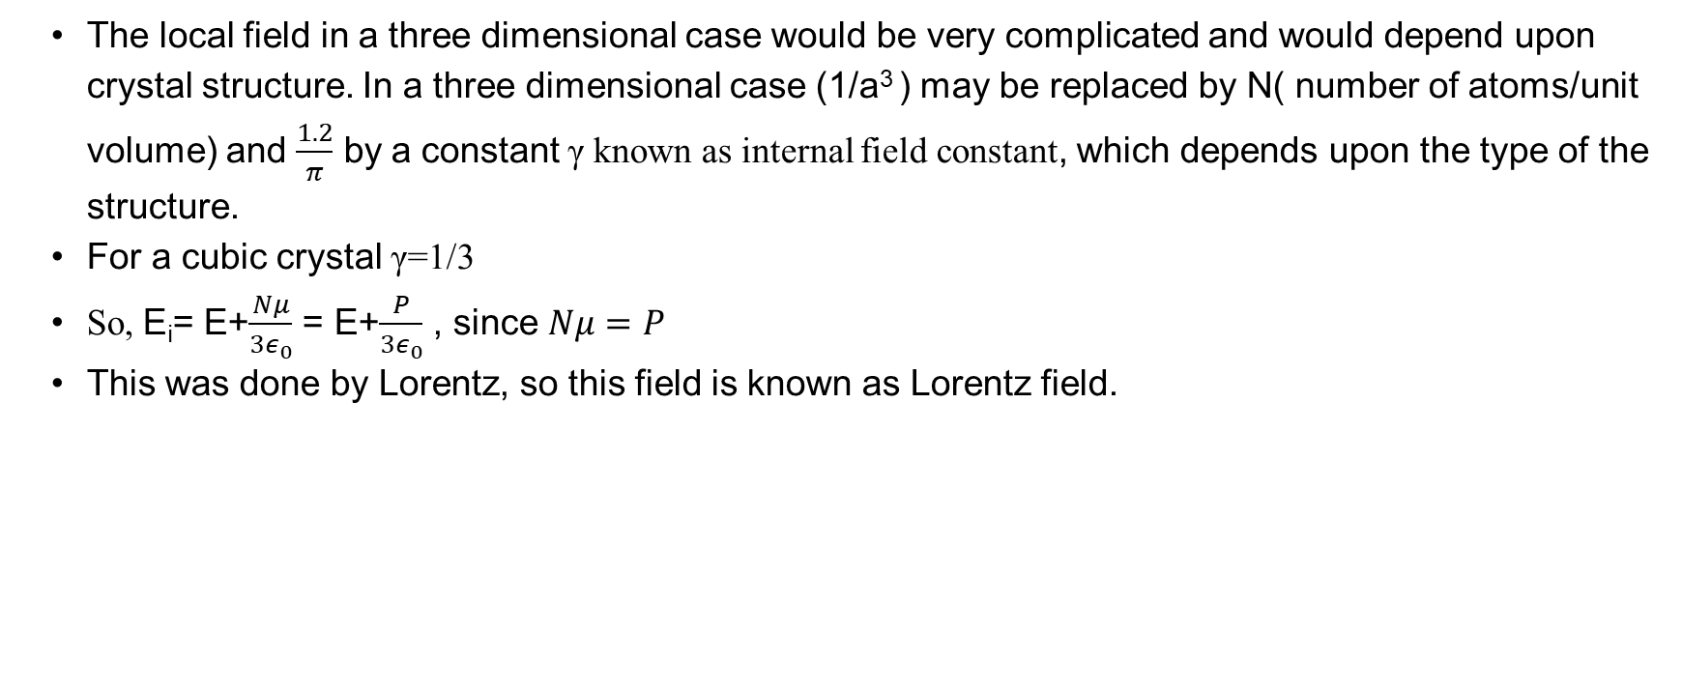
The local field in a three dimensional case would be very complicated and would depend upon crystal structure. In a three dimensional case (1/a³ ) may be replaced by N( number of atoms/unit volume) and $\frac{1.2}{π}$ by a constant γ known as internal field constant, which depends upon the type of the structure.
For a cubic crystal γ=1/3
So, E_{i}= E+$\frac{Nμ}{3ε_{0}}$ = E+$\frac{P}{3ε_{0}}$ , since $Nμ=P$
This was done by Lorentz, so this field is known as Lorentz field.

Slide 35
5.6 Clausius Mossotti Relation
Clausius Mossotti relation relates dielectric constant of an insulator to the polarizability of atoms comprising it.
We know that dipole moment of a single atom is proportional to the local field or internal field.

Slide 36
i.e., dipolemoment= αE_{i}……………………………….(1)
where α is the polarizability of the atom.
The bulk polarisation, P=N αE_{i} …………………(2) where N is the number atoms per unit volume and E_{i} is the local field or internal field.

Slide 37

From equation (2), α =$\frac{P}{NEi}$
=$\frac{P}{N( E+\frac{P}{3ε_{0}})}$ ……………………(3)
But we know that P=${E∈}_{0}(∈_{r}−1)$…………………..(4)
E=$\frac{P}{∈_{0}(∈_{r}−1)}$ ……………………………(5)
Substitute eqn (5) in (3), α = $\frac{P}{N(\frac{P}{∈_{0}(∈_{r}−1)} +\frac{P}{3ε_{0}})}$

Slide 38

Or $\frac{Nα}{∈_{0}}$= $\frac{1}{(\frac{1}{(∈_{r}−1)} +\frac{1}{3})}$
Or $\frac{Nα}{∈_{0}}$ =$\frac{1}{\frac{(∈_{r}+2)}{(∈_{r}−1)} }$
$\frac{(∈_{r}−1)}{(∈_{r}+2)}=\frac{Nα}{{3∈}_{0}}$ …………………………..(6)
This equation is known as Clausius Mossotti Relation

Slide 39
Dielectric loss
When a dielectric material is placed in an alternating electric field, some amount of electrical energy is absorbed by the medium, that is a part of energy is wasted. This is due to the reversing of polarisation due to the presence of positive and negative field.

Slide 40
Dielectric power loss , P= jV²ωCtanΦ, where C is the capacitance of the dielectric and V is the voltage applied to it at a frequency f, tan Φ is the power factor of the dielectric. That is, the power loss depends on the power factor tan Φ of the dielectric, since V, ω,and C are kept constant.

Slide 41
Dielectric breakdown
When a voltage is applied to a dielectric material it can withstand upto a maximum field intensity, beyond which damage occurs , that results in breakdown. This phenomenon in which the dielectric material fails to resist large applied voltage is known as dielectric breakdown and the corresponding voltage is known as breakdown voltage. The different types of dielectric break down are given below.

Slide 42
Intrinsic breakdown
Thermal breakdown
Discharge breakdown
Electro chemical breakdown
Defect break down

Slide 43
Intrinsic breakdown
In a pure dielectric , valance band is separated from conduction band with a very large band gap, so the electrons cannot cross the band gap to reach the conduction band . If it is subjected to a large amount of electric field , the valance electrons acquire sufficient amount of energy so that they can cross the energy gap. This produce large current, which causes the dielectric material to undergo a breakdown.

Slide 44
Thermal breakdown
Thermal breakdown is the breakdown due to the heat generated in the dielectric material when an electric field is applied. In certain cases the amount of heat generated is very high compared to the heat dissipated and this excess of heat may produce dielectric breakdown. This type of breakdown is called thermal breakdown.

Slide 45
Electro chemical breakdown
Electrochemical breakdown is closely related with thermal breakdown. Due to the effect of temperature, mobility of ions increases , hence electrochemical reaction will takes place, which results in leakage current . This decreases the insulation resistance and this will result in dielectric breakdown.

Slide 46
Discharge breakdown
It is due to the presence of gas or liquid filled cavities or voids within the dielectric material.If these materials are subjected to high voltage it get ionised and they produce ionisation current . This large ionisation current may produce dielectric breakdown and is known as discharge breakdown

Slide 47
Defect breakdown
It is due to the surface defects like cracks, pores etc. Impurities are filled up at these places which results in breakdown. This is known as defect breakdown

